Slide 1
Informative and Controllable Opinion Summarization
Advisor: JIA-LING, KOH
Source: ACL,21
SPEAKER: Rui Ze Fang
DATE: 2021/11

Slide 2
Outline
Introduction
Method
Experiment
Conclusion

Slide 3
Introduction

Slide 4
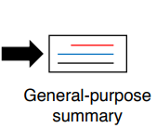
Introduction
《No game no life : 遊戲人生》
多篇評論
使用者

Slide 5
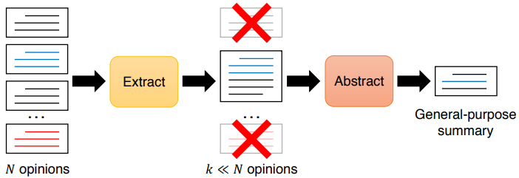
Opinion Summarization
Input:
All of reviews
Challenge :
only a small subset of reviews, the summaries can be less informative

Slide 6
Condense-Abstract
Each review (X)
Input:
All of reviews

Slide 7
Method

Slide 8
Method

Slide 9
Condense
Encoder
$$z_{0}$$
Decoder

Slide 10
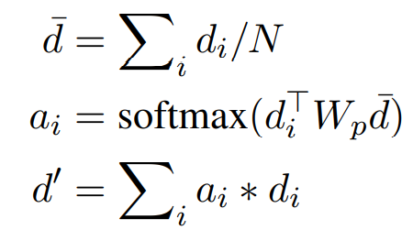
Multi-source Fusion
{$d_{1}$, $d_{2}$, … , $d_{N}$}
Word-level encoding
{$h_{i,1}$, $h_{i,2}$, … , $h_{i,N}$}
$V_{wj}$代表number of tokens for word $w_{j}$

Slide 11
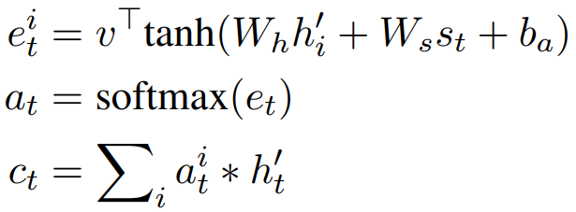
Decoder
Salience-biased Extracts

Slide 12
Salience-biased Extracts
BERT
Word-level encoding
{$h_{1}$, $h_{2}$, … , $h_{N}$}
Average
$$d_{1}$$
$$d_{2}$$
Average
$$c$$
$$d_{3}$$
$$d_{N}$$
取與 c 最接近前 K 個${ d}_{i}$ 所對應的reviews concatenate成一個long sequence再經過 BiLSTM encode 和 LSTM decode 得到${ r}_{t}$

Slide 13
Decoder

Slide 14
Loss function
$n_{i}$ is the encoding of one of five randomly sampled negative summaries

Slide 15
Need-specific summary
{$d_{1}$, $d_{2}$, … , $d_{N}$}
Word-level encoding
{$h_{i,1}$, $h_{i,2}$, … , $h_{i,N}$}
$V_{wj}$代表number of tokens for word $w_{j}$

Slide 16
Experiment

Slide 17
Experiment

Slide 18
Experiment

Slide 19
Experiment

Slide 20
Conclusion

Slide 21
Conclusion
CONDASUM is superior to purely extractive models and abstractive models that include an extractive pre-selection stage.
CONDASUM is able to generate need-specific summaries at test time.

Slide 22
結束

Slide 23
Opinosis-Graph

Slide 24
METEOR

